Slide 1
transformRNA
- transforming domestic R&D to the global level

Slide 2
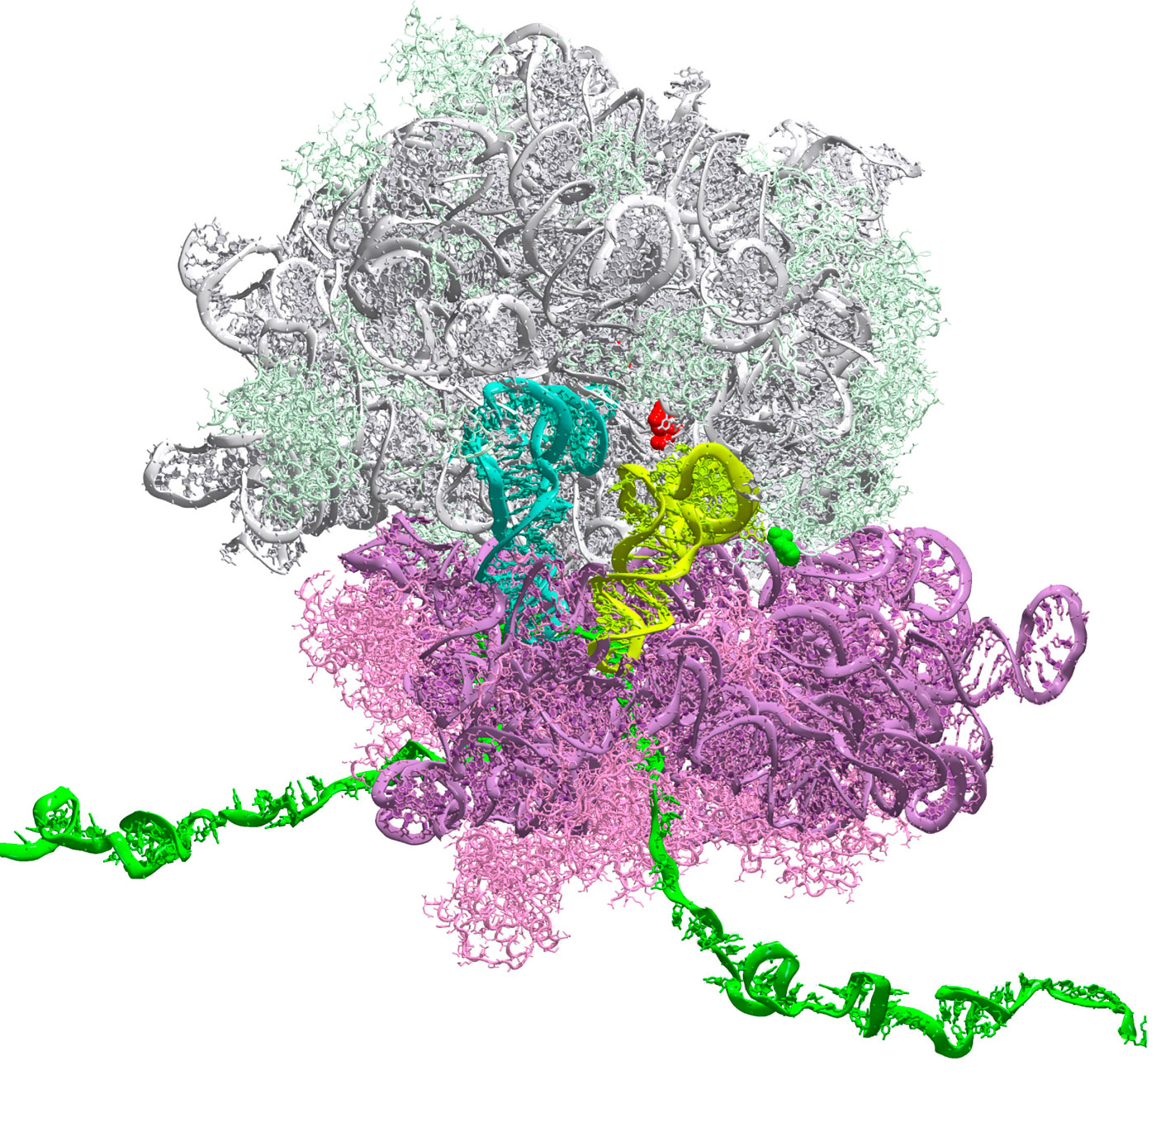
transformRNA
- program introduction
Program goals:
establishment of a state of art mRNA technology platform in the applicant’s R&D facility,
development, design, and evaluation of efficacious mRNA-based therapeutics for the treatment of COVID-19 (development of polyvalent mRNA anti-SARS-COV-2 emerging mutants), cancer and alpha 1-antitrypsin deficiency,
development and evaluation of effective formulation and mRNA delivery systems, addressing different target organs,
certification and validation of the company’s brand new GMP production facility and Fill and Finish zone for mRNA production (API), characterization, and final product market release,

Slide 3
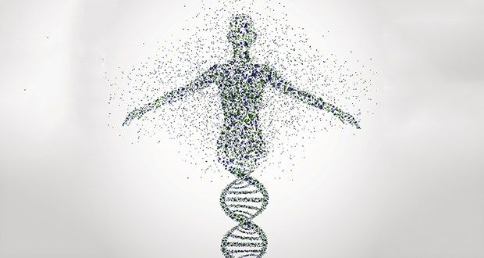
mRNA technology
- disenchanting the myths
Why mRNA technology has become a major weapon against COVID 19 pandemic?
the oldest information carrier in the history of life on earth,
it is universal and recognized by virtually all the cells of our body,
contains direct information about the structure and structure of target proteins,
organisms have developed effective methods of its elimination, which ensures its efficient processing and minimization of toxic effects,
it is easy to modify, and to produce,
it is non-toxic and does not integrate into the cell machinery structure,

Slide 4
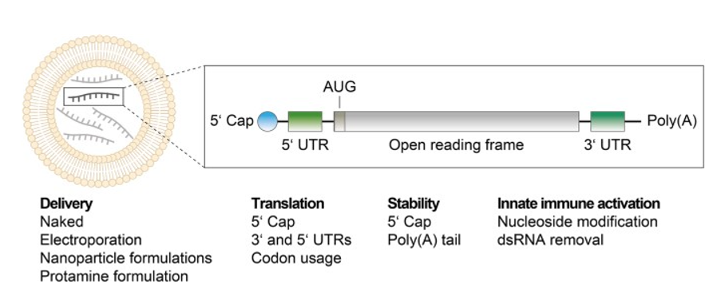
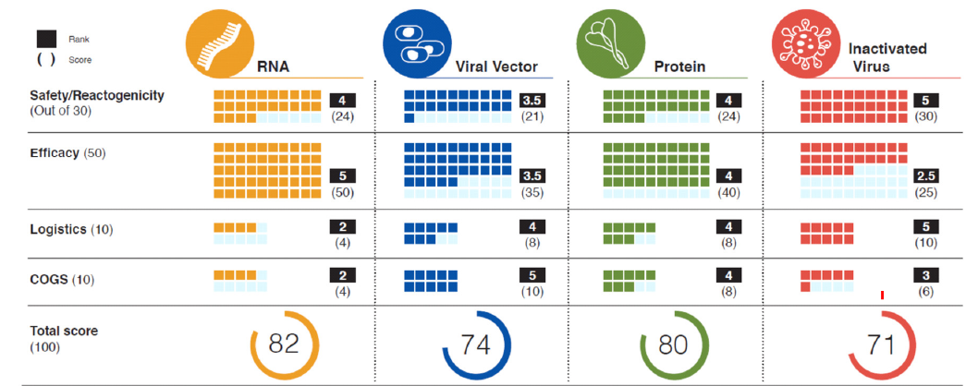
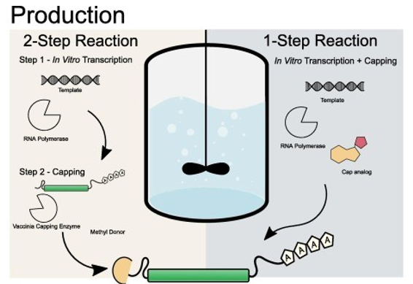
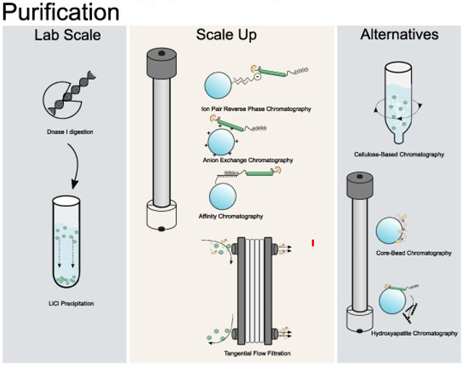
mRNA technology
- disenchanting the myths
Why mRNA technology holds the potential to change the medicine ?
due to the production process - it can be easily adapted as a weapon against rapidly changing viruses and neoplasms,
due to its structure – it is unstable (safe) but easy to modify (increase its activity) and contains direct information about the structure and activity of target proteins,
Ranking of four vaccine platforms according to criteria for harmonized target product profile
Origin: Funk at al. Viruses 2021

Slide 5
mRNA technology
- disenchanting the myths
PROGRAM SUMMARY:
PROGRAM SCHEDULE
2021 |  | 2022 |  | 2023 |  | 2024 |  | 2025 |  | 2026 |  | 2027
mRNA CANDIDATES DESIGN
the overall duration of the program is schedule for 72 months,
later stages of the program starting from toxicology cover the development of at least 3 drug candidates in three intended indications,
free therapeutic indications,
program budget – 140 mln PLN,
MEDICAL RESEARCH AGENCY (ABM) support – over 83,5 mln PLN.
IN VITRO CANDIDATES SELECTION
IVT, PRODUCTION AND PURIFICATION,
DEVELOPMENT AND SCALE UP
FORMULATION DEVELOPMENT
PK/PD, ADME AND IN VIVO EFFICACY STUDIES
LARGE SCALE PRODUCTION OF non-GMP AND GMP MATERIAL
– CLINICAL RELEASE
IND ENABLING TOXICOLOGY STUDIES
PHASE I STUDIES – 3 PROGRAMS
PHASE II STUDIES - 2 PROGRAMS

Slide 6
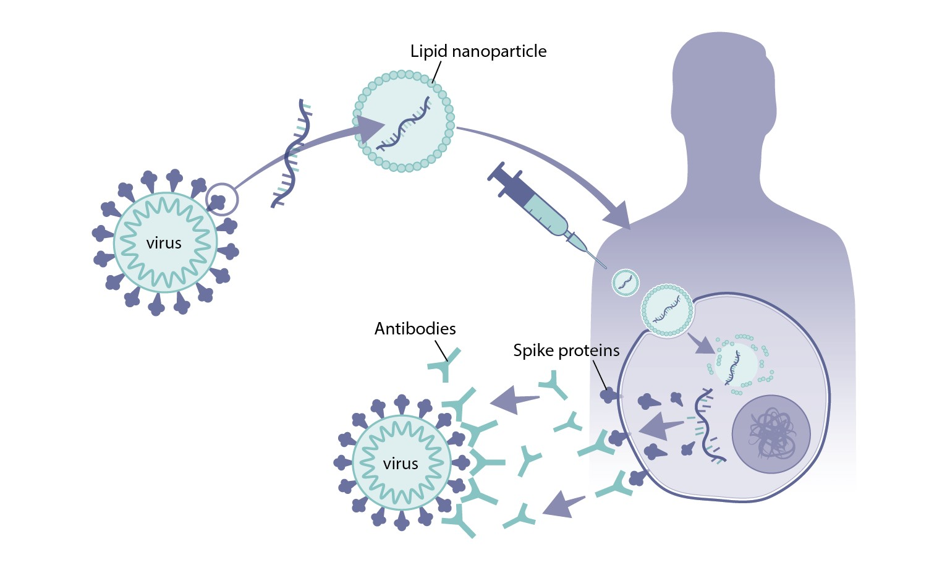
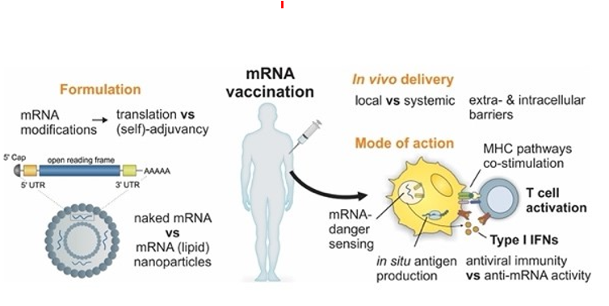
mRNA technology
- disenchanting the myths
transformRNA - tailored made mRNA technology platform aiming to design therapeutics in three most important therapeutic indications:
anti-SARS-COV-2 VACCINE,
anti-cancer vaccines and therapeutics – four targets: TROP2 vaccine, FGFRc receptor isoform vaccine, cancer-specific mRNA therapeutics,
mRNA based alpha 1- antitrypsin deficiency supplementary therapy,
Origin: Funk at al. Viruses 2021

Slide 7
Thank you !!!

