Slide 1
mRNA anticancer Vaccines breakthrough approach in cancer treatment
tTROP2, FGFR2c

Slide 2
mRNA vaccines in oncology - current status
Several products at early or clinical exploratory stages
Moderna, Biontech and Curevac having almost 70% of oncological vaccines in early pipeline
Two targeting approaches:
Multiply tumor associated antigens or sinle specific antigen
Most indications in immunosensitive tumors: melanoma, NSCLC, glioblastoma

Slide 3






TROP2 and tTROP2 - small difference with huge biological impact
Cyclin D1, Claudin-7 and others
Proteolitic cleavage
Anti-tTROP2 specific vaccine effect
P
P
333
Oncogenic signalling
Based partly on Goldenberg et al., 2018

Slide 4
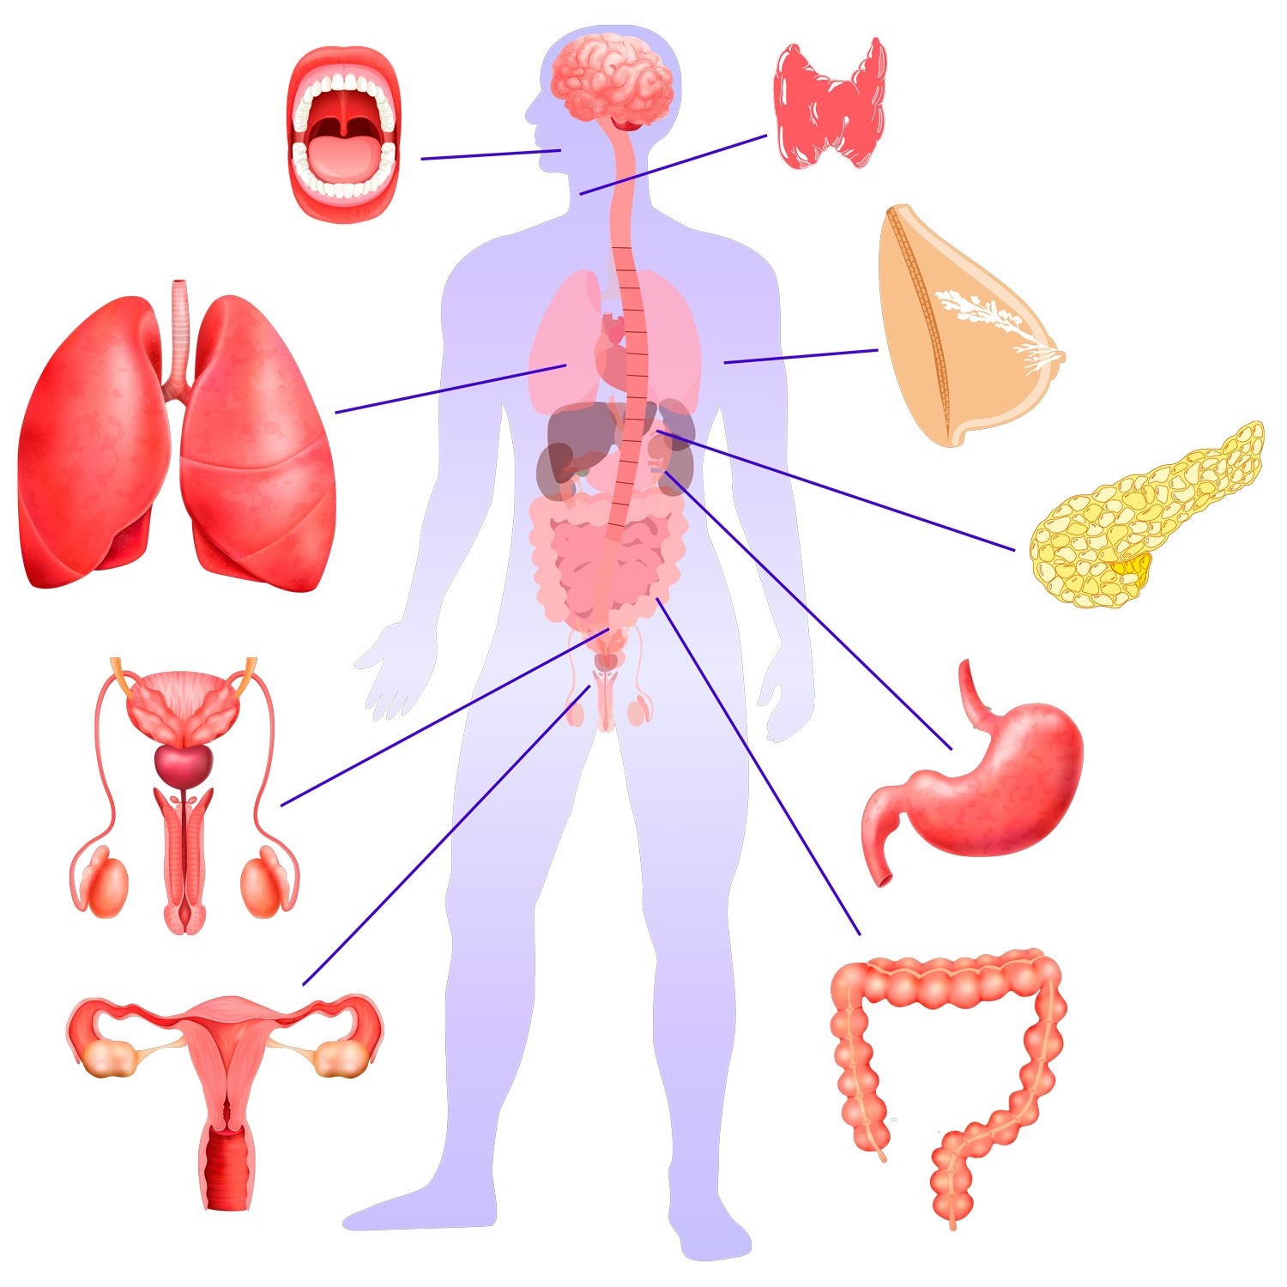
tTROP2 in solid tumors
Oral squamous cell carcinoma 58%
83% Papillary thyroid carcinoma
80% of breast cancers
88% of TNBCs
NSCLC adenocarcinoma 64%
NSCLC squamous 75%
55% of pancreatic cancers
Urothelial cancers 80%
Prostate cancer 71%
56% of gastric carcinoma
Endometrial cancers 72%
Cervical cancer 89%
68% of colon cancer
Liao et al., 2020

Slide 5
tTROP2 targets in solid tumors evidence
Trerotola et al., 2021
Fong et al., 2008; Ohmachi et al., 2006

Slide 6
FGFR2c biology
FGFR2c is the result of alternative splicing
Oncogenic signalling
EMT (pathogenic type)
invasiveness
Lei et al., 2021

Slide 7
FGFR2c in solid tumors
Pancreatic cancer
(>70% overexpression)
Prostate and bladder cancer
(overexpression not precisely
determined)
Endometrial cancer
(>40% overexpression)
Sengal et al., 2020; Fagonee et al., 2020, Ishiwata aet al., 2021

Slide 8
Celon mRNA vaccines in oncology:
CHALLENGES | OPPORTUNITIES
New delivery, not yet used at Celon (NLP licence/technology) | Emerging (hot) technology with huge market potential for partnering
Adjuvant selection | Entering novel (difficult to target molecular targets)
Off-targeting risk | Better safety/efficacy profile
 | Platform technology with ease-to-modife targets

Slide 9
Dziękuję!

